Slide 1
Adult Income
Analysis | Aug 17, 2024
Data set: here
Jupyter notebook with analysis: here

Slide 2
Pre-analysis Assumptions
Income increases with age.
Income increases with higher education.
Income increases with number of hours worked per week.

Slide 3
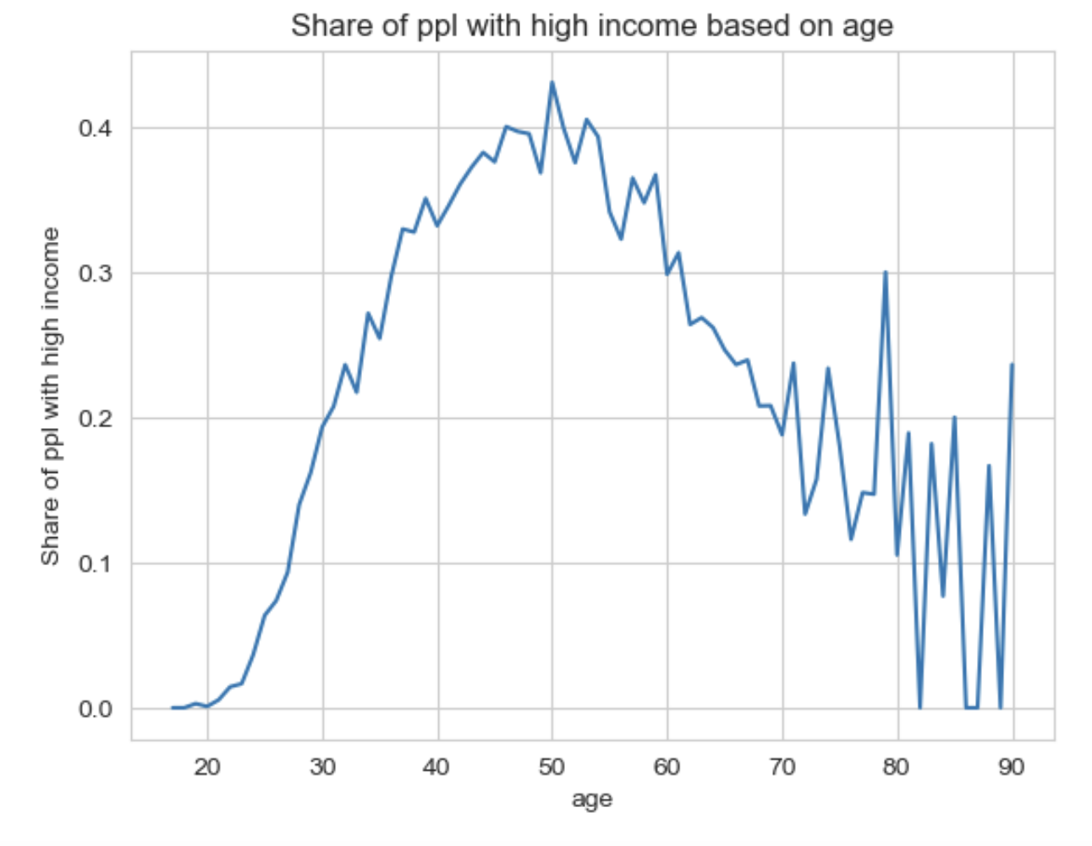
Does income increase with age?
Income keeps increasing until the age of 50, and then starts to decrease.
Notes:
Which makes sense, since level and education, experience and expertise keeps increasing with age, and after 50 ppl start retiring or working less.

Slide 4
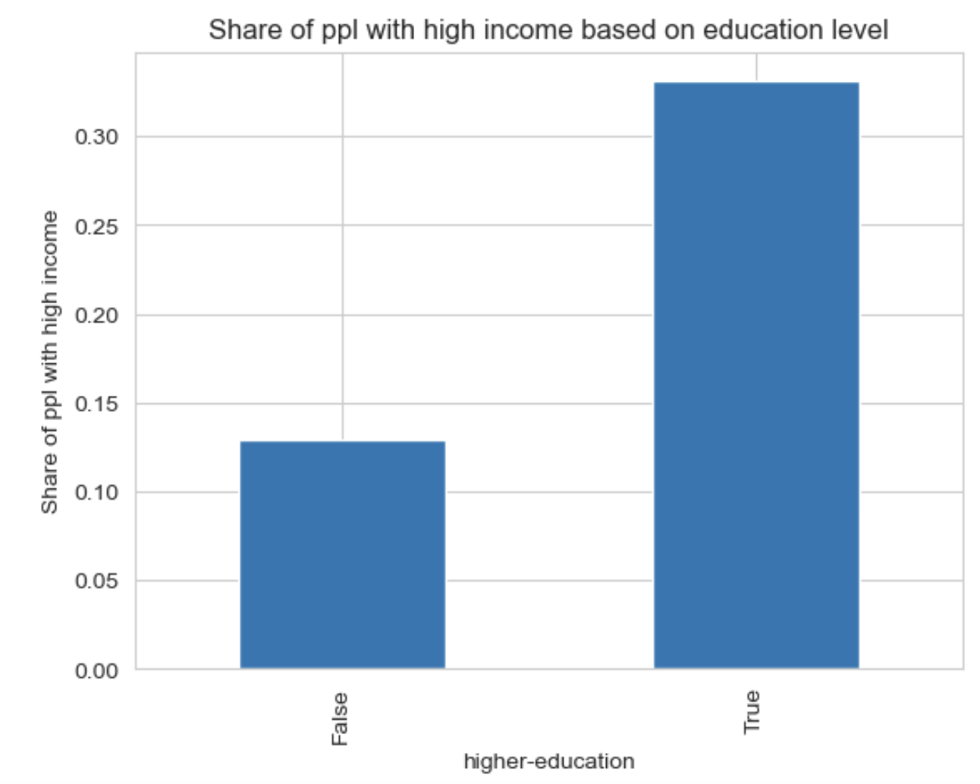
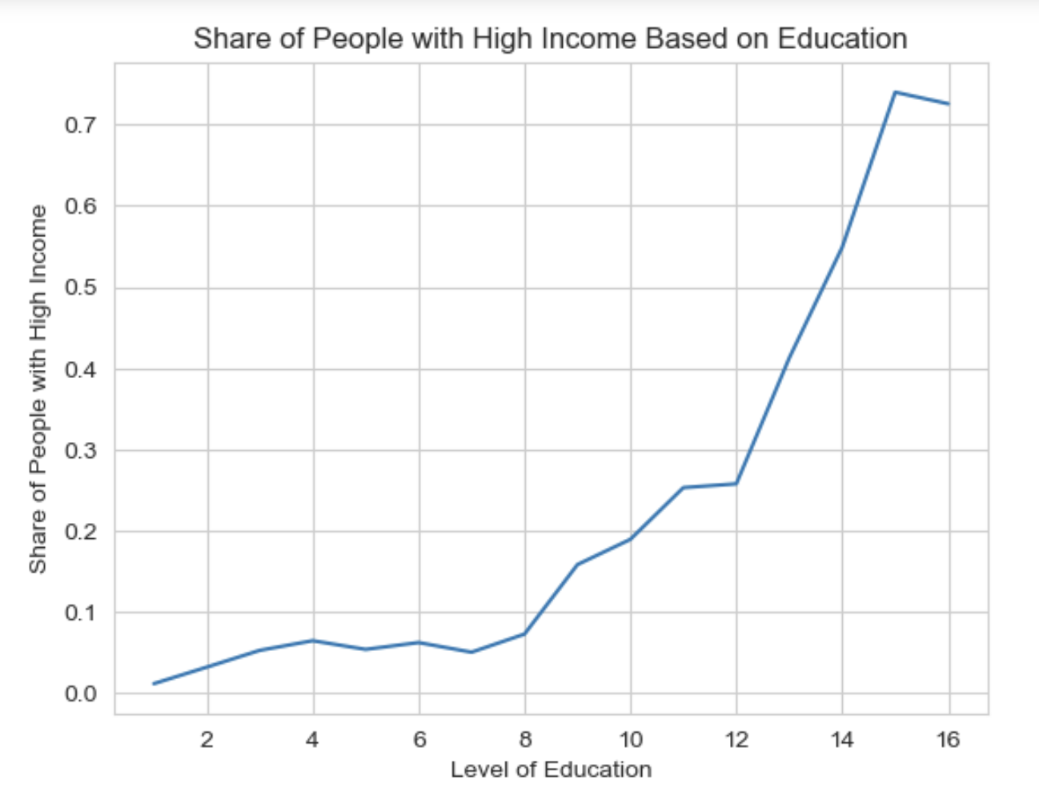
Does income increase with higher education?
Higher education
A higher share of ppl with higher education has high income.
Income keeps increasing as the level of education increases.

Slide 5
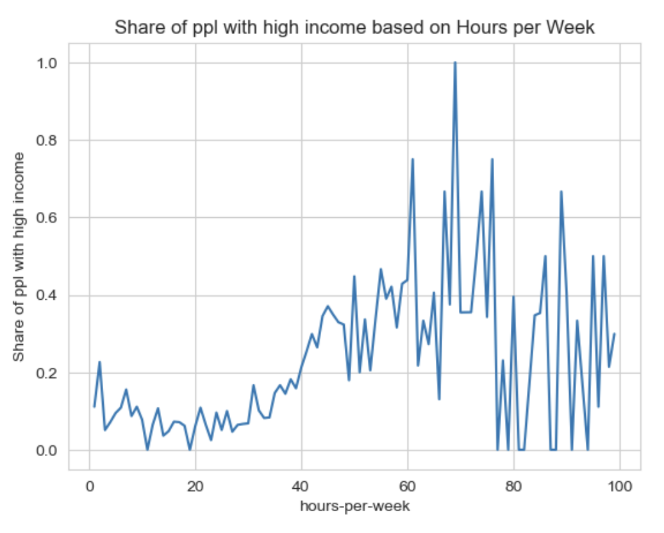
Does income increase with number of hours?
Income keeps increasing until roughly 60 hours per week and then becomes erratic.

Slide 6
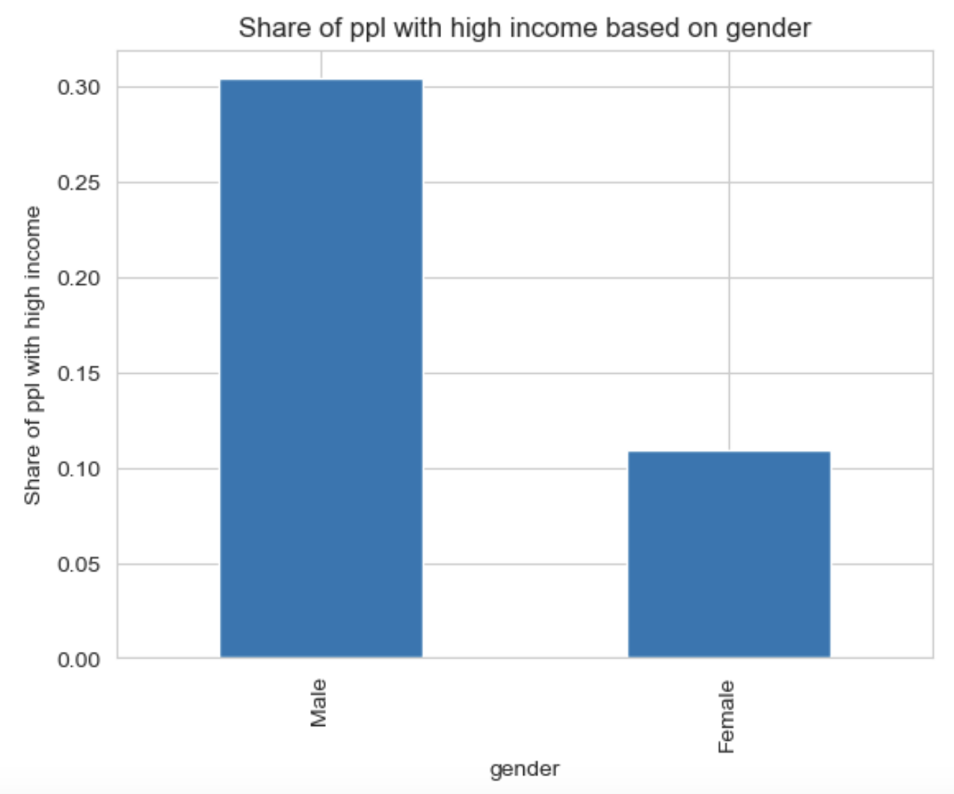
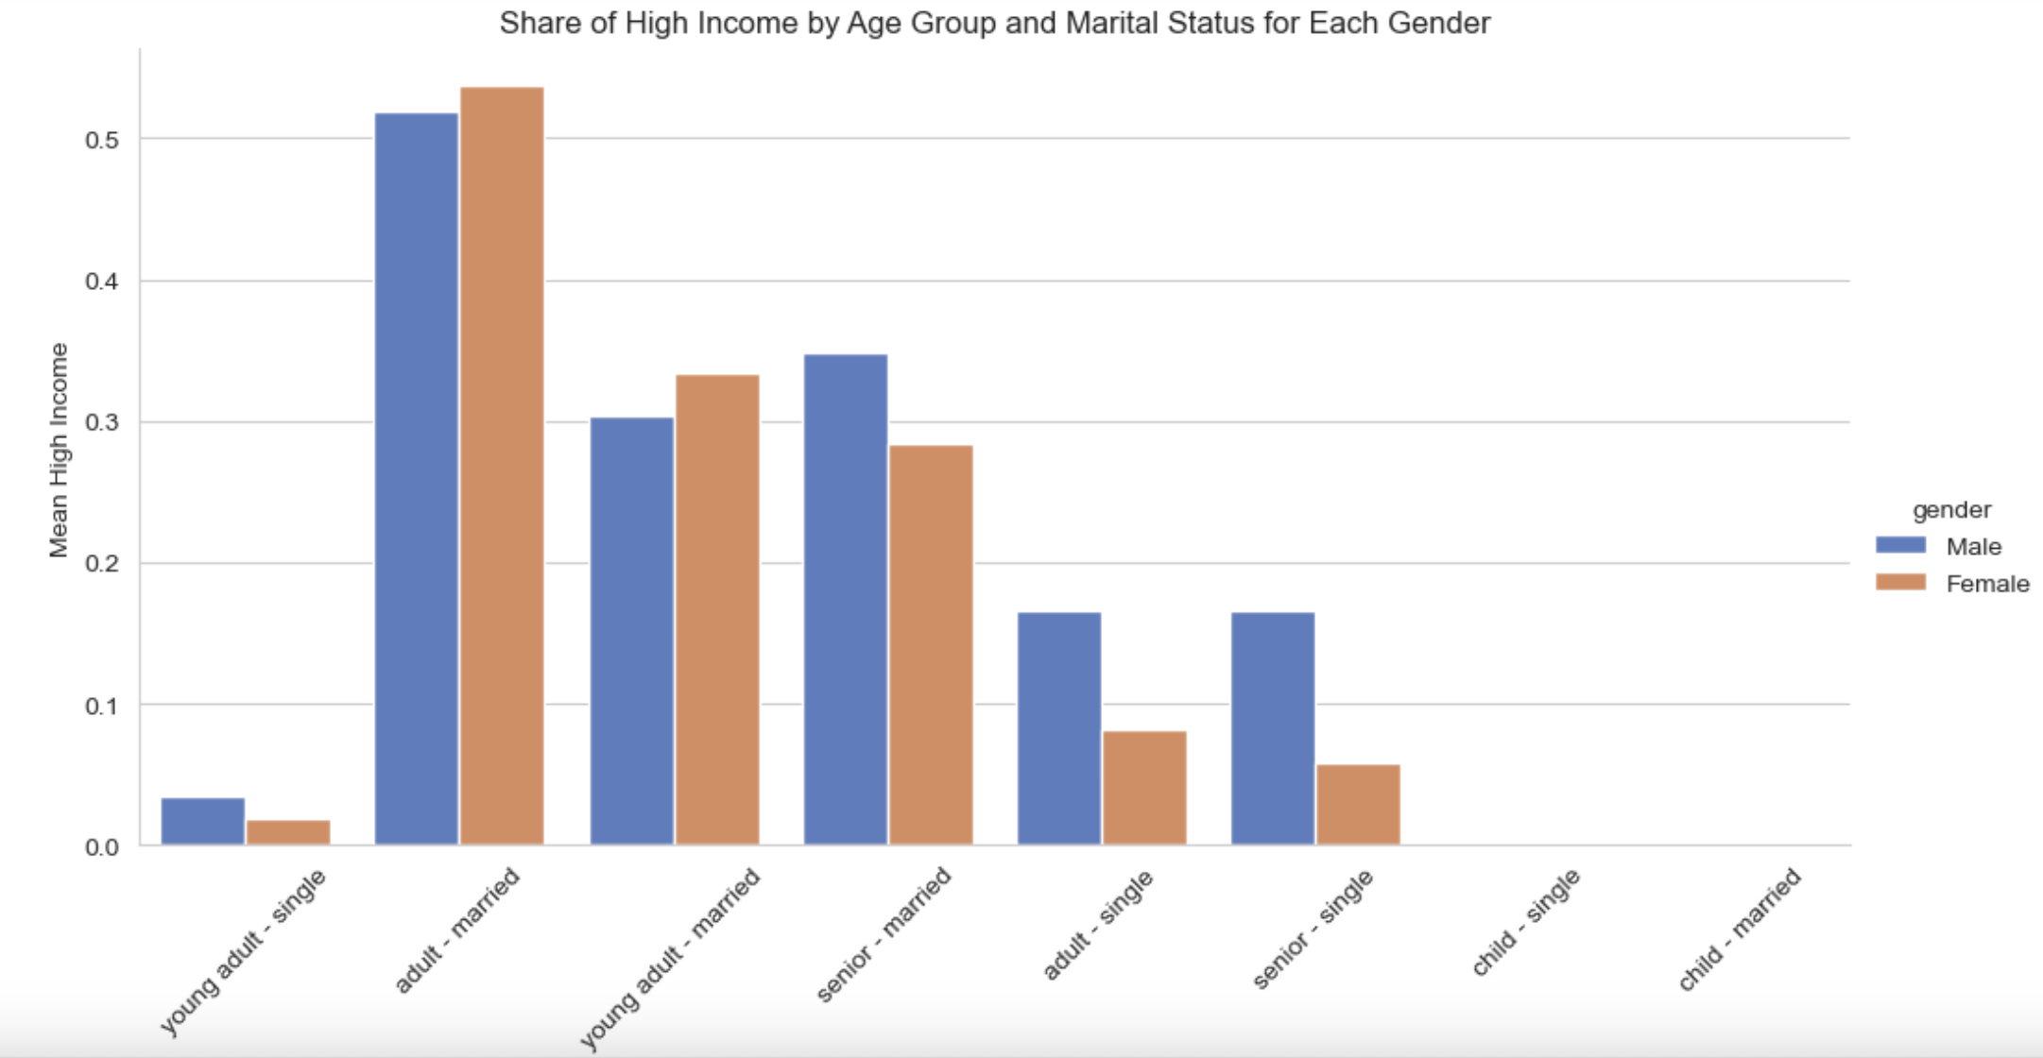
Does income depend on gender?
At first glance, there’s a gap in income between men and women.
However, as we overlay more dimensions – specifically age and marital status – the difference becomes less clear-cut.
Notes:
There are confounding factors that may explain the gap in income between men and women.

Slide 7
Interesting observation
Having a spouse is associated with higher income.
Notes:
What could be an intuitive explanation for this?

Slide 8
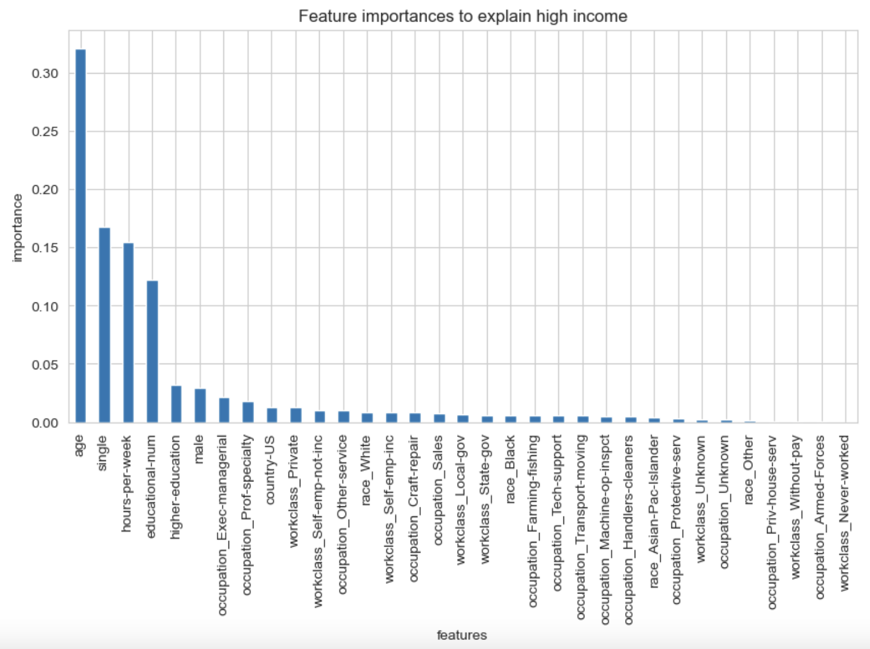
Summary of important features
Notes:
After creating a statistical model – only 4 features are important in explaining high income: age, marital status, number of hours worked, and level of education.

